Slide 1




Multi-Intent Classification in Chatbots Review-2
Project Guide
Dr. E. Sivasankar
Project Team Members
106118058 Asif
106118085 Sampurn
106118116 Supria

Slide 2
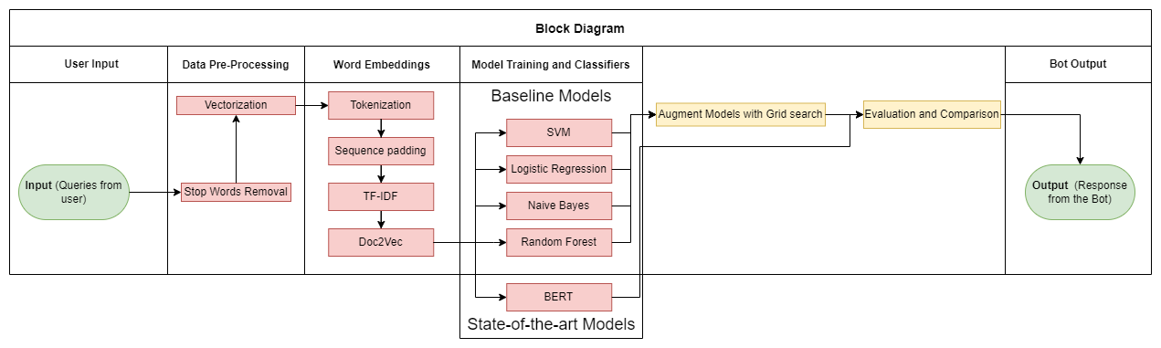
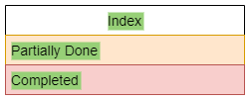
Block Diagram

Slide 3
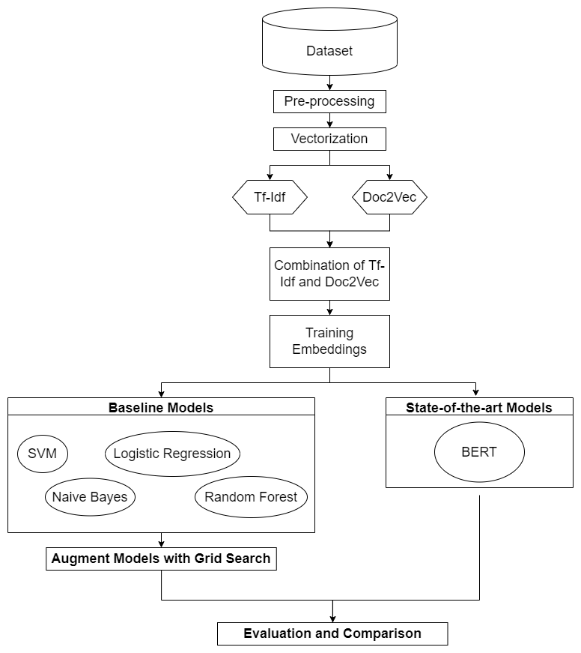
Overall methodology Flow-chart

Slide 4
Test Cases
Module Name | Test case id | Input | Expected output
Lemmization + Stopwords | 01 | ['available flight from Moscow to Delhi'] | ['available','flight','Moscow','Delhi']
Tokenization + Padding |  | ---- | ----
Deep learning models (RNN,GRU,BILSTM) |  | ---- | ----
Integrated all modules | 02 | "show me flights from boston to pittsburgh" | atis_flight has confidence = 0.9999726 atis_airfare has confidence = 1.3132179e-05 atis_quantity has confidence = 6.5181957e-06 atis_ground_service has confidence = 4.479258e-06 atis_aircraft has confidence = 1.9002763e-06 atis_airline has confidence = 6.9674377e-07 atis_flight_time has confidence = 4.061908e-07 intent has confidence = 2.0724524e-07 atis_abbreviation has confidence = 7.5757317e-10

Slide 5


Evaluation metrics with formula
The measures that have been used to evaluate the performance of the models are accuracy and F1 score.
Accuracy is defined as the ratio of correct predictions to the total number of instances present in the dataset. The accuracy is given by:
F1 score is basically a weighted average of precision and recall. It is given by the formula:
Where in the above equations, TP stands for True Positive, FP stands for False Positive and FN stands for False Negative.

Slide 6
Evaluation metrics with formula
bilstm
Accuracy: 0.9245087900723888
Macro F1 Score: 0.4557639735299608
Micro F1 Score: 0.9245087900723888
Weighted F1 Score: 0.9071200402658504
simple rnn
Accuracy: 0.7693898655635988
Macro F1 Score: 0.10870835768556399
Micro F1 Score: 0.7693898655635988
Weighted F1 Score: 0.6691128696426855
gru
Accuracy: 0.7797311271975181
Macro F1 Score: 0.10952934340499709
Micro F1 Score: 0.7797311271975181
Weighted F1 Score: 0.6832275071550595

Slide 7
Comparison analysis

Slide 8
ATis Dataset
The ATIS dataset is a standard benchmark dataset widely used as an intent classification.
ATIS Stands for Airline Travel Information System.
It consists of audio recordings and corresponding manual transcripts about humans asking for flight information on automated airline travel inquiry systems.
The data consists of 17 unique intent categories.
ATIS dataset provides large number of messages and their associated intents that can be used in training a classifier and what makes it so effective is that the speech has many of the characteristics of spontaneous spoken language (e.g., disfluencies, false starts, and colloquial pronunciations)
Link: https://github.com/ChatBot-FYP-NITT/MIC_Project/blob/2309ffefe2f68269474d5f86ea585e539d614ae2/atis_intents_train.csv

Slide 9
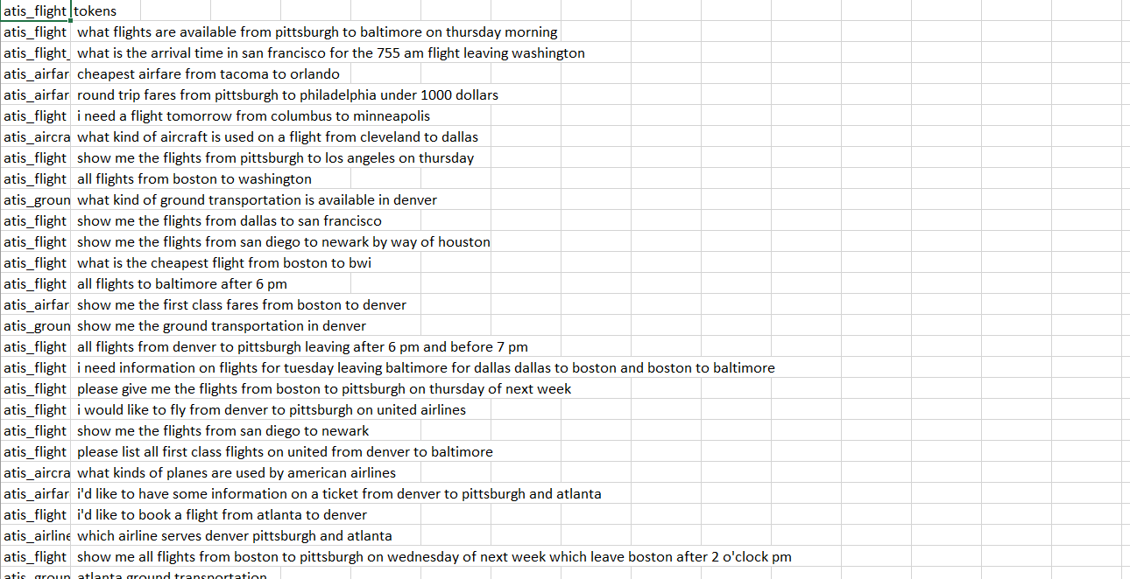
ATis Dataset

Slide 10
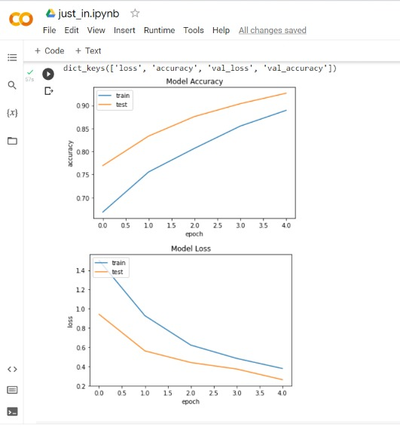
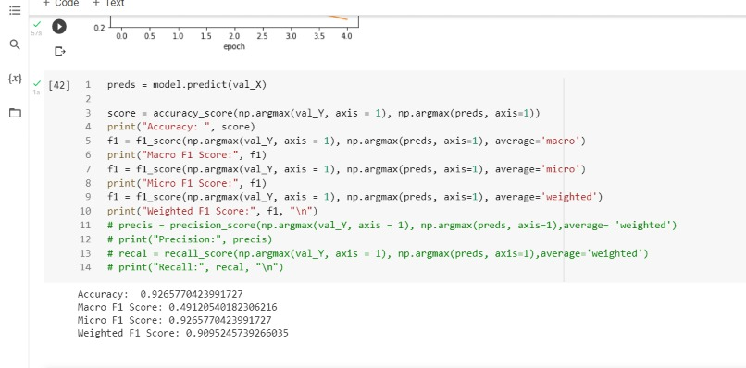
Screen Shots
BiLSTM:

Slide 11
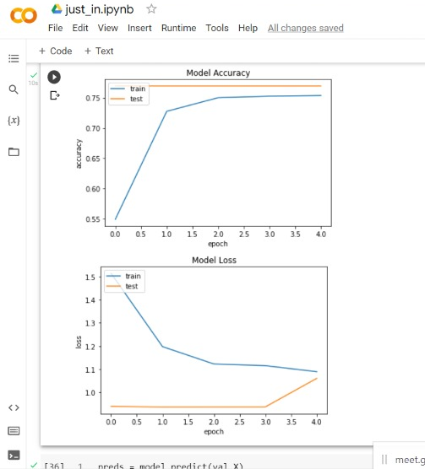
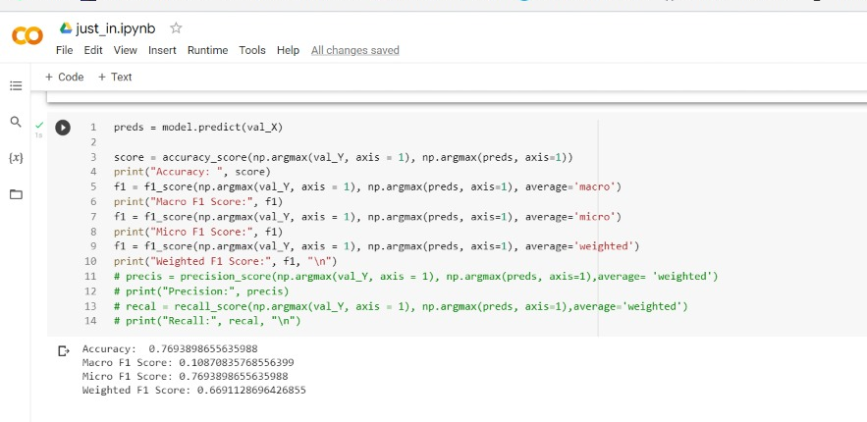
Screen Shots
Simple RNN:

Slide 12
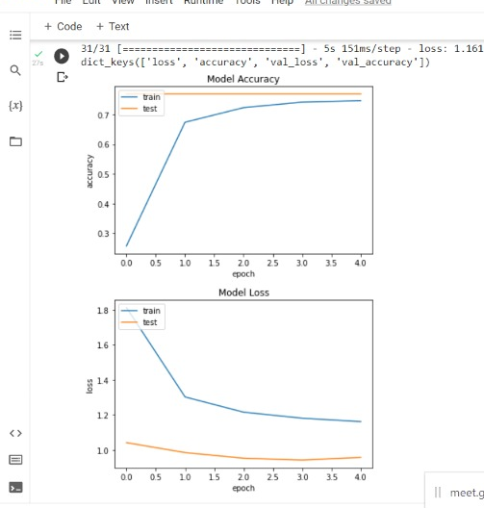
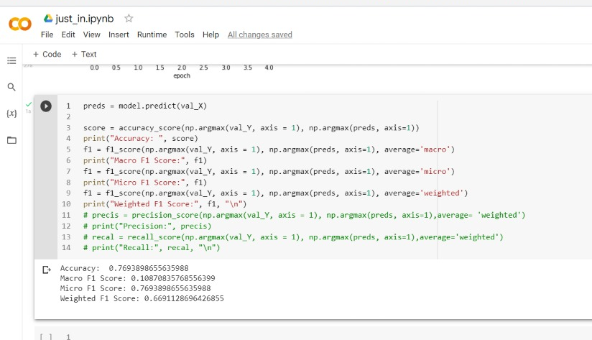
Screen Shots
GRU:

Slide 13
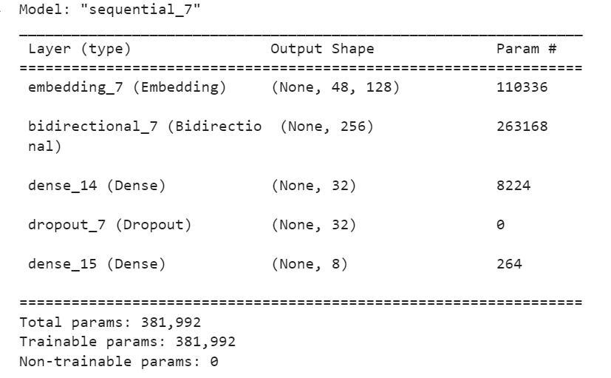
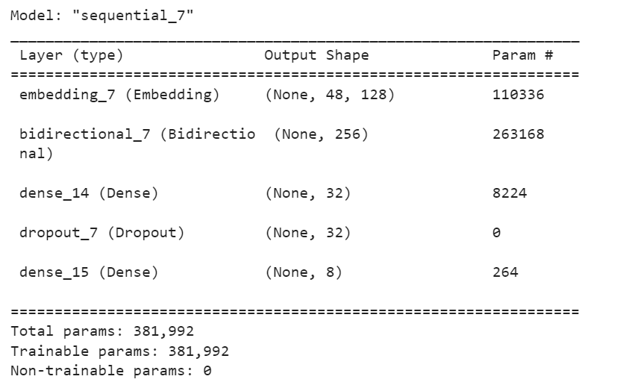
Screen Shots

Slide 14
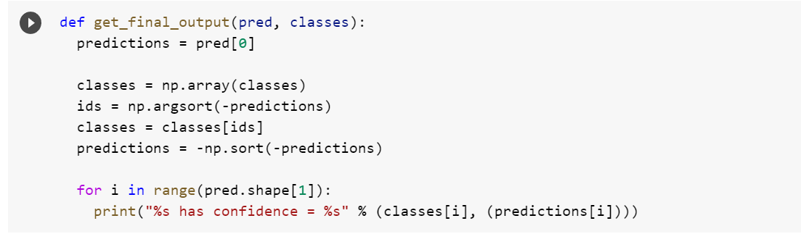
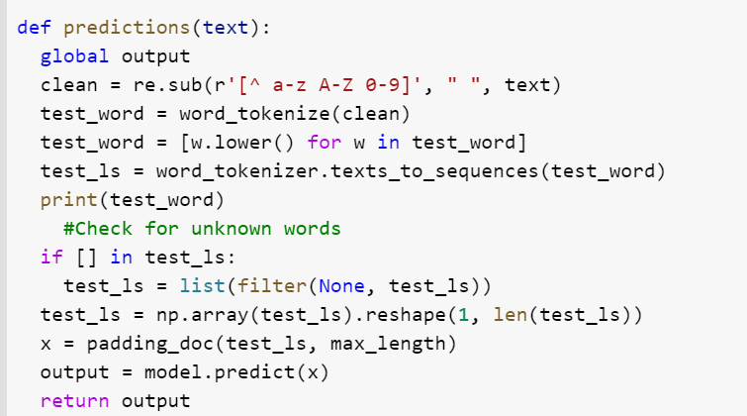
Screen Shots
Final Output:
Prediction:

Slide 15
References
1.J. Schuurmans and F. Frasincar, (2020) "Intent Classification for Dialogue Utterances," in IEEE Intelligent Systems, vol. 35, no. 1, pp. 82- 88, https://doi.org/10.1109/MIS.2019.2954966 .
2.T. -Y. Chen, Y. -C. Chiu, N. Bi and R. T. -H. Tsai, (2021) "Multi-Modal Chatbot in Intelligent Manufacturing," in IEEE Access, vol. 9, pp. 82118- 82129 https://doi.org/10.1109/ACCESS.2021.3083518
3.A. Benayas, R. Hashempour, D. Rumble, S. Jameel and R. C. De Amorim, (2021) "Unified Transformer Multi-Task Learning for Intent Classification With Entity Recognition," in IEEE Access, vol. 9, pp. 147306-147314, https://doi.org/10.1109/ACCESS.2021.3124268
4.T. -Y. Chen, Y. -C. Chiu, N. Bi and R. T. -H. Tsai, (2021) "Multi-Modal Chatbot in Intelligent Manufacturing," in IEEE Access, vol. 9, pp. 82118-82129, 2021, https://doi.org/10.1109/ACCESS.2021.3083518
5.M. Kumar, V. Kumar, H. Glaude, C. de Lichy, A. Alok and R. Gupta(2021) "PROTODA: EFFICIENT TRANSFER LEARNING FOR FEW-SHOT INTENT CLASSIFICATION" in IEEE https://doi.org/10.1109/SLT48900.2021
6.Zixian Feng, Caihai Zhu, Weihan, Zhang, Zhigang Chen, Wanxiang Che, Minlie Huang, Linlin Li (2021), "An Evaluation of Chinese Human-Computer Dialogue Technology" MIT Press Direct Data Intelligence (2021) 3 (2): 274–286, https://doi.org/10.1162/dint_a_00090
7.Tulika Saha, Dhawal Gupta, Sriparna Saha, and Pushpak Bhattacharyya (2021) “A Unified Dialogue Management Strategy for Multi-intent Dialogue Conversations in Multiple Languages” in ACM Trans. Asian Low-Resour. Lang. Inf. Process, Vol - 20, 6, Article 99 (November 2021), 22 pages. https://doi.org/10.1145/3461763
Our Code:
https://colab.research.google.com/drive/1oDH_HWDDg_nmSm4G8iyMjyeHdImf13y-?usp=sharing&pli=1#scrollTo=XRFKXzek7Qsf

